Slide 1
Wedding Planner Program Presentation
Introduction
Welcome to our wedding planner program presentation.
We've developed a Java program to assist you in planning weddings.
This program allows you to input details such as the bride and groom's names, wedding date, and location, and then it outputs a wedding plan.

Slide 2
Program Overview
Our program consists of four classes:
Person: Represents a person with a first name and last name.
Couple: Represents a couple, consisting of a bride and groom as Person class object.
Wedding: Represents a wedding event, including the couple, wedding date, and location.
TestWedding: A test class to demonstrate the functionality of the program by taking input from the console and displaying the wedding plan.

Slide 3
How to Use the Program
To use the program, follow these steps:
Run TestWedding class
Input the required details when prompted:
Month, day, and year of the wedding.
First and last names of the bride and groom.
Location of the wedding.
The program will then display the wedding plan.

Slide 4
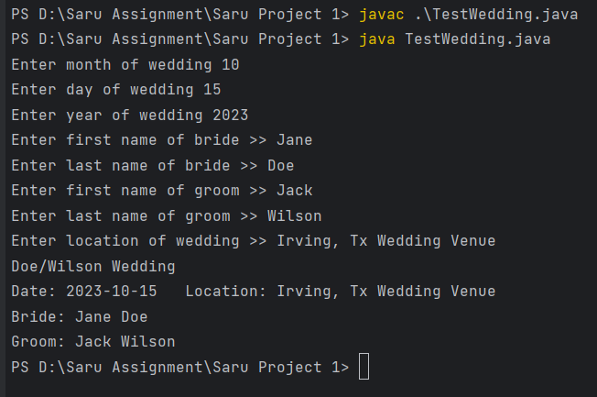
Program Execution
Let's see the program in action:
Run TestWedding class. Console will be prompted for input.
javac TestWedding.java (compiles the code)
java TestWedding.java (runs the code)
Console Prompts for input and displays output

